Slide 1



2025 ARC and PLC Signup
Recommendations for Wisconsin Farmers
Dr. Paul D. Mitchell
Professor of Agricultural and Applied Economics
Extension State Specialist in Cropping Systems Management
Director Renk AgriBusiness Institute
January 17, 2025
608-320-1162 pdmitchell@wisc.edu
https://aae.wisc.edu/pdmitchell/extension/arc-plc-signup/

Slide 2
Topics Covered
Recommendations for corn, soybeans, wheat, and oats
SCO and ECO
Recommendations for minor crops
Not Covered: How PLC and ARC work
Types of farms that may find ARC-IC a useful option

Slide 3
ARC and PLC Signup Deadline: April 15, 2025
Farmers choose PLC or ARC-CO (or ARC-IC) for their base acres
Can mix and match across farms and crops
  Use PLC for your corn base and ARC-CO for your soybean base
  Use PLC for corn on one farm, ARC-CO for corn on another
Signup is only for 2025 crops (2024 crops already chosen)
  Payments based on marketing year average prices from Sep 1, 2025 until Aug 31, 2026
  If payments are triggered, they will be made in Sep/Oct of 2026

Slide 4
ARC and PLC: Reminder of how they work
PLC: Pays if the national marketing year average price falls below the Effective Reference Price (PLC Trigger)
ARC: Pays if actual county revenue below county revenue guarantee
  Actual County Revenue = national PLC price x NASS county yield
  County Revenue Guarantee = 86% of Olympic average of county revenue for 2019-2023, with reference price as price floor
  Wisconsin spreadsheet of prices and county yields and guarantees
  https://aae.wisc.edu/pdmitchell/wp-content/uploads/sites/15/2025/01/2025-Price-County-Data-Post.xlsx
  National database of county yields and guarantees: https://www.fsa.usda.gov/documents/arcco-2025-data-20250106

Slide 5
Initial ARC/PLC Recommendations for 2025
If had to decide today: PLC for Corn and ARC for Soybeans, Wheat and Oats
No Rush, you have until April 15th to make your election
  Market uncertainty high due to supply and demand issues and policy uncertainty: WASDE has surprised markets this year
  USDA Long-run Baseline published mid-Feb will have 2025 price estimates
  2025 Prospective Plantings Report published Mar 31
  Policy Uncertainty: Will Trump impose tariffs? What will Congress do?
  I will update my recommendations as the sign-up period progresses
File your FSA Enrollment form for 2025 soon (2025 CCC-866)
  Your 2024 ARC/PLC Elections will automatically transfer to 2025
Update your Elections for 2025 before April 15th if you want to

Slide 6
2025 Effective Prices and Farm Price Projections
PLC Trigger
ARC “Trigger”
Crop | 2025 Effective Reference Price | 2025 Effective ARC Price | Projected 2025 Farm Price
Corn | $4.26 | $4.32 | $3.90
Soybeans | $9.66 | $10.46 | $10.00
Wheat | $5.56 | $5.78 | $5.80
Oats | $2.76 | $3.24 | $2.90
Effective Reference Prices (Dec 31, 2024)
https://www.fsa.usda.gov/documents/2025-erp-pdf
Effective ARC Prices: Price needed to trigger ARC payments if have average (benchmark) county yield
Projected 2025 Farm Prices: USDA Early-Release Baseline Projections (Nov 7, 2024)
https://www.usda.gov/oce/commodity-markets/baseline

Slide 7

Corn Prices and Effective Reference Prices

Slide 8
ARC “Trigger”
PLC Trigger
Projected Price
Projected Price well below the PLC Trigger (Effective Reference Price) and the ARC “Trigger”
Both ARC and PLC likely to pay
With average county yields and projected price, ARC is close to hitting payment maximum (10% of county benchmark revenue)
Recommendation: Choose PLC
ARC not a bad choice
Crop Price $/bu)

Slide 9
Soybean Prices and Effective Reference Prices

Slide 10
ARC “Trigger”
Projected Price
PLC Trigger
Projected Price well above the PLC Trigger and well below the ARC “Trigger”
ARC likely to pay even with above average county yields
PLC much less likely to pay
Recommendation: choose ARC
Crop Price $/bu)

Slide 11
Wheat Prices and Effective Reference Prices

Slide 12
Projected Price
ARC “Trigger”
PLC Trigger
Projected Price well above PLC Trigger and just above the ARC “Trigger”
ARC likely to pay if have modest county yield losses or worse
PLC much less likely to pay
Recommendation: choose ARC
Crop Price $/bu)

Slide 13
Oat Prices and Effective Reference Prices

Slide 14
ARC “Trigger”
Projected Price
PLC Trigger
Projected Price above the PLC Trigger and well below the ARC “Trigger”
ARC likely to pay even with above average county yields
PLC much less likely to pay
Recommendation: choose ARC
Crop Price $/bu)

Slide 15
PLC ARC ARC ARC
ARC “Trigger”
Projected Price
PLC Trigger
Crop Price $/bu)

Slide 16
Initial 2025 ARC/PLC Recommendations
Signup opens Jan 21, Deadline is April 15
  Enroll for 2025 soon, your 2025 Elections transfer, update Elections later
  Key USDA updates to be published, some policy uncertainty will be resolved
  I will update my recommendations as the sign-up period progresses
Corn: Choose PLC: Projected Price well below PLC and ARC triggers, so both ARC and PLC payments are likely, but ARC could hit payment maximum
Soybeans & Oats: Choose ARC-CO: ARC “Trigger” exceeds Projected Prices, so ARC payments likely; PLC payments less likely and, if paid, will be smaller
Wheat: Choose ARC-CO: Projected Price just above ARC “Trigger”, well above PLC trigger, so (small) ARC payments more likely than any PLC payments
If you buy SCO crop insurance by Mar 15th, you must choose PLC for that crop by Apr 15th or you will void your SCO coverage (premium still due)

Slide 17
Supplemental Coverage Option (SCO)
SCO: allows you to insure part of your RP/YP deductible with a county policy (ARP/AYP)
  Layer individual & county coverage
  Can’t exceed 86% for total coverage
Add SCO to your RP policy to increase coverage up to the 86% of your expected revenue
  SCO will not pay until county loss exceeds 14%
  65% SCO premium subsidy (farmer pays 35% of premium)
SCO available, but only if you choose PLC for the insured crop
  If choose ARC for a crop, cannot buy SCO for that crop

Slide 18
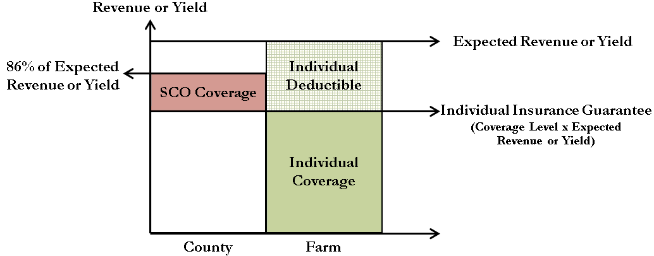

Possible outcomes with RP plus SCO
1. SCO pays, but not RP (low county yield, good farm yield)
2. RP pays, but not SCO (good county yield, low farm yield)
3. Both SCO and RP pay (low prices, low county and low farm yield)
4. Neither SCO nor RP pays (high prices, good county and good farm yield)

Slide 19
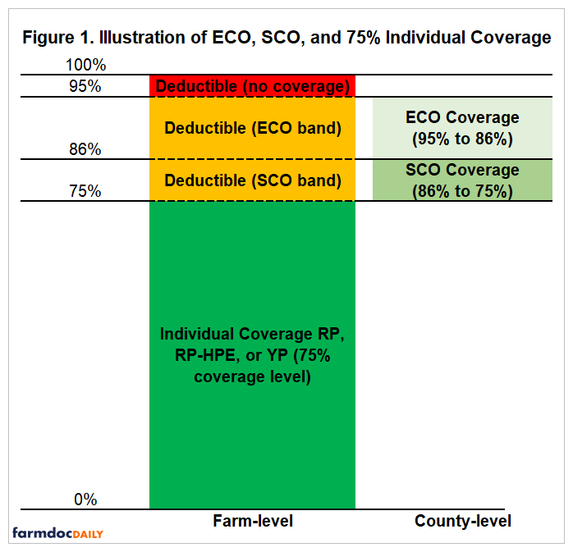
Enhanced Coverage Option (ECO)
ECO: also allows you to insure part of your RP/YP deductible with a county policy (ARP/AYP)
Covers from 86% up to 95% of expected revenue
Can use ECO whether sign up for ARC or PLC
Can add ECO on top of SCO or use ECO instead of SCO
New in 2025: ECO premium subsidy now 65% just like SCO
https://farmdocdaily.illinois.edu/2020/11/the-new-enhanced-coverage-option-eco-crop-insurance-program.html

Slide 20
Farmer Use of SCO and ECO in Wisconsin
SCO Insured Acres in Wisconsin
% Acres with SCO in Wisconsin
Year | Corn | Soybeans | Wheat | Oats
2020 | 268,611 | 77,653 | 700 | 399
2021 | 266,633 | 107,243 | 6,708 | 297
2022 | 221,059 | 107,246 | 5,320 | 366
2023 | 253,805 | 116,905 | 3,326 | 277
2024 | 84,927 | 74,293 | 2,147 | 417
Year | Corn | Soybeans | Wheat | Oats
2020 | 6.8% | 3.8% | 0.4% | 0.1%
2021 | 6.8% | 5.1% | 2.3% | 0.2%
2022 | 5.7% | 5.0% | 1.8% | 0.3%
2023 | 6.3% | 5.5% | 1.2% | 0.2%
2024 | 2.3% | 3.5% | 0.8% | 0.3%
ECO Insured Acres in Wisconsin
% Acres with ECO in Wisconsin
Year | Corn | Soybeans | Wheat | Oats
2021 | 239,315 | 105,401 |  | 352
2022 | 240,520 | 122,333 | 5,340 | 274
2023 | 270,994 | 118,918 | 2,056 | 339
2024 | 348,901 | 137,511 | 1,687 | 271
Year | Corn | Soybeans | Wheat | Oats
2021 | 6.1% | 5.0% |  | 0.2%
2022 | 6.2% | 5.7% | 1.8% | 0.2%
2023 | 6.8% | 5.6% | 0.7% | 0.3%
2024 | 9.4% | 6.4% | 0.6% | 0.2%

Slide 21
Initial 2025 ARC/PLC Recommendations
Signup opens Jan 21, Deadline is April 15
  Enroll for 2025 soon, your 2025 Elections transfer, update Elections later
  Key USDA updates to be published, some policy uncertainty will be resolved
  I will update my recommendations as the sign-up period progresses
Corn: Choose PLC: Projected Price well below PLC and ARC triggers, so both ARC and PLC payments are likely, but ARC could hit payment maximum
Soybeans & Oats: Choose ARC-CO: ARC “Trigger” exceeds Projected Prices, so ARC payments likely; PLC payments less likely and, if paid, will be smaller
Wheat: Choose ARC-CO: Projected Price just above ARC “Trigger”, well above PLC trigger, so (small) ARC payments more likely than any PLC payments
If you buy SCO crop insurance by Mar 15th, you must choose PLC for that crop by Apr 15th or you will void your SCO coverage (premium still due)

Slide 22

Minor Crops: Reference Prices and USDA Projected Prices
PLC Trigger
ARC “Trigger”
Crop | 2025 Effective Reference Price | 2025 Effective ARC Price | Projected 2025 Farm Price
Barley | $4.95 | $5.06 | $5.75
Sunflower | $20.15 | $20.15 | $20.05
Sorghum | $4.51 | $4.56 | $3.80
Effective Reference Prices (Dec 31, 2024)
https://www.fsa.usda.gov/documents/2025-erp-pdf
Effective ARC Prices: Price needed to trigger ARC payments if have average (benchmark) county yield
Projected 2025 Farm Prices: USDA Early-Release Baseline Projections (Nov 7, 2024)
https://www.usda.gov/oce/commodity-markets/baseline

Slide 23
Barley Prices and Effective Reference Prices

Slide 24
Projected Price well above the PLC Trigger (Effective Reference Price) and the ARC “Trigger”
ARC and PLC unlikely to pay
Recommendation: Choose ARC because there is always a small chance that county yields will be low enough to trigger payments
Projected Price
ARC “Trigger”
PLC Trigger
Crop Price $/bu)

Slide 25
Sunflower Seed Prices and Effective Reference Prices

Slide 26
PLC Trigger
ARC “Trigger”
Projected Price
Projected Price below the PLC Trigger and the ARC “Trigger”
Both ARC and PLC likely to pay
Recommendation: Choose PLC because it has slightly higher expected payments
ARC not a bad choice
$20.15
Crop Price $/bu)

Slide 27
Sorghum Prices and Effective Reference Prices

Slide 28
PLC Trigger
Projected Price
Projected Price well below the PLC Trigger and ARC “Trigger”
Both ARC and PLC likely to pay
With average county yields and projected price, ARC will hit payment maximum (10% of county benchmark revenue)
Recommendation: Choose PLC so unusually high county yields do not reduce payments
ARC “Trigger”
Crop Price $/bu)

Slide 29
ARC PLC PLC
$20.15
ARC “Trigger”
PLC Trigger
Projected Price
Crop Price $/bu)

Slide 30
Initial 2025 ARC/PLC Recommendations
Signup opens Jan 21, Deadline is April 15
  Enroll for 2025 soon, your 2025 Elections transfer, update Elections later
  Key USDA updates to be published, some policy uncertainty will be resolved
  I will update my recommendations as the sign-up period progresses
Barley: Choose ARC-CO: Neither likely to pay, but always a small chance of an ARC payment due to unusually low county yield
Sunflowers: Choose PLC: Small ARC and PLC payments likely, PLC has slightly higher expected payments
Sorghum: Choose PLC: Projected Price well below PLC and ARC triggers, so both ARC and PLC payments are likely, but ARC likely to hit payment maximum

