Slide 1
Cost Economics
AAE 320
Paul D. Mitchell

Slide 2
Goal of Section
Overview what economists mean by Cost
(Economic) Cost Functions
  Derivation of Cost Functions
  Concept of Duality
  What it all means

Slide 3
Economic Cost
Economic Cost: Value of what is given up whenever an exchange or transformation of resources takes place
For an exchange of resources (a purchase) not only is money given up, but also the opportunity to do some thing else with that money
For a transformation of resources (including time), the opportunity to do other things with those resources is given up

Slide 4
Economic Cost vs Accounting Cost
Economics includes these implicit costs in the analysis that standard accounting methods do not include
Accountants ask: What did you pay for it? Explicit Cost
Economists also ask: What else could you do with the money? Explicit Cost, plus Implicit Cost (Opportunity Cost)

Slide 5
Economic Cost vs Accounting Cost
Economic cost ≠ accounting cost
Accounting Cost: Used for financial reporting (balancing the books, paying taxes, etc.)
  Typically uses reported prices, wages and interest rates (explicit costs)
Economic Costs: Used for decision making (resource allocation, developing strategy)
  Includes opportunity costs (implicit costs) in the analysis and calculates depreciation differently

Slide 6
Economic Cost vs Accounting Cost
Accounting Profit
= Revenue – Explicit Cost
Economic Profit
= Revenue – Explicit Cost
– Implicit Cost + Implicit Benefits
Economic analysis includes implicit costs and implicit benefits that accounting does not include
Zero economic profit does not mean you are not making money, but that you are making as much money as you should, a “normal” rate of return

Slide 7
Opportunity Cost
Implicit Costs = “Opportunity Costs”
Value of the best opportunity given up because resources are used for the given transaction or transformation
“Value of the next best alternative”
Value of what you could do with your time & money
Opportunity Cost of Farming: Think of the Counter-factual: What would you be doing if not farming?
  Opportunity cost of your time
  Opportunity cost of your assets and capital

Slide 8
Opportunity Cost
What’s your next best alternative?
Opportunity Cost of Time
  Usually assume a different job and estimate the implied lost wages
Opportunity Cost of Capital
  Usually assume a low risk investment alternative like bonds or CD and estimate the implied lost returns on capital
Opportunity Cost of Asset (land)
  Usually assume rental rate

Slide 9
Opportunity Cost of Time
Assume you make $50,000 as a farmer
Your next best job pays $45,000 = Opportunity Cost of your Time as a farmer
Typical way of thinking: Accounting profit = $50,000
Economic way of thinking: look at difference in pay
  Treat $45,000 as an “opportunity cost” and subtract it from your current salary
  Economic profit = $50,000 – $45,000 = $5,000
  You are making $5,000 more with current job than in your next best opportunity

Slide 10
Opportunity Cost of Capital
You have equity in your farm, your money invested in the farm
If you invest the money in a company (owned stock), bought bonds, or a CD, they would pay you a dividend
We will use returns on these investments as a way to estimate the opportunity cost of capital: you give up X% rate of return
What rate of return are you making by keeping your money in the farm? Covered later in semester
Typical way of thinking: you have $100,000 equity in a farm, earning 5% return = $5,000 annually
Economic way of thinking: treat the potential investment income as an opportunity cost of capital: you could have earned 3% in the bond market, so opportunity cost is $3,000
Economic profit = $5,000 – $3,000 = $2,000

Slide 11
Opportunity Cost of Working Assets
You have land and other “working assets” on a farm as well, not just capital invested as equity
Instead of using them to farm, you could rent them out to someone else at market rates, but still own them
  Alternative opportunity to consider instead of the conversion to “cash” in a hypothetical sale
This is the opportunity cost for you to use these assets to farm
Land, buildings, tractors, machinery, milk cows, breeding livestock (bulls, cows, …)
You earn $300/acre growing crops, land rents for $200 in area
Accounting profit is $300/A, economic profit is $100/A

Slide 12
Economic Profit vs Accounting Profit
Accounting profit is the “normal” way of thinking: I make $50,000 as a farmer, I earn a 5% rate of return on my farm equity, I make $300/A growing crops
Economic profit: How do these compare to what else you could make with these?
  Alternatives: $45,000 salary, $100,000 at 3% = $3,000 investment, and $200/A land rent
You are making a positive economic profit: very good
  $5000 more in salary, 2% more than market rates, $100/acre more in return to land
If economic profit is zero, you are making as much as you can—no better opportunities exist for you

Slide 13
Economic Benefits
Economic profit includes benefits accounting methods do not
Accounting Profit = Revenue – Explicit Cost
Economic Profit = Revenue – Explicit Cost – Implicit Cost + Implicit Benefits
What benefits do you get from an activity besides money?
Economics develops ways to estimate these types of benefits or values based on available data
If you accept a below market salary/rate of return for a job, you must be getting other economic benefits

Slide 14
Main point of this section
“Cost” in economics is more comprehensive than accounting cost
Exposure to concept of opportunity cost
Start New Section: Cost Functions

Slide 15
Cost Definitions
Cost Function: schedule or equation that gives the minimum cost to produce the given output Q, e.g., C(Q)
Cost functions are not the sum of prices times inputs used: C = r_{x}X + r_{y}Y
C = r_{x}X + r_{y}Y is cost as a function of the inputs X and Y, not cost as a function of output Q

Slide 16
Cost Functions
Output Price = Marginal Cost (P = MC) identifies how much output Q to produce
Profit, production function and prices identify inputs to use VMP = r, this gives output Q
Cost depends on inputs used and their prices, but how much of each input to use?
Mathematical wonders of duality needed to fully explain how it works

Slide 17
Main Point
If you choose Q so that price = marginal cost, the inputs needed to produce this level of output at minimum cost will satisfy the optimality conditions we have already seen: VMP_{x} = r_{x} and MP_{x}/MP_{y} = r_{x}/r_{y}
Duality implies that a cost function with standard properties implies a production function with standard properties

Slide 18
Fixed Cost (FC)
Costs that do not vary with the level of output Q during the planning period
Cost of resources committed through previous planning
Property Taxes, Insurance, Depreciation, Interest Payments, Scheduled Maintenance
In the long run, all costs are variable because you can change assets

Slide 19
Variable Cost (VC)
Costs that change with the level of output Q that is produced
Manager controls these costs
Fertilizer, Seed, Herbicides, Feed, Grain, Fuel, Veterinary Services, Hired Labor
Vary the relative amounts used as increase output produced

Slide 20
Cost Definitions
Total Cost TC = fixed cost + variable cost
Average Fixed Cost AFC = FC/Q
Average Variable Cost AVC = VC/Q
Average Total Cost ATC = TC/Q
Marginal Cost MC = cost of producing the last unit of output = slope of the TC = slope of the VC = dTC/dQ = dVC/dQ

Slide 21
Cost Function Graphics
TC
VC
Cost
FC
Output Q

Slide 22
TC
Average Costs = slope of line through the origin to the point on the function
Cost
Output Q

Slide 23
TC
VC
Cost
ATC
AVC
Minimum AVC
Minimum ATC
Output Q

Slide 24
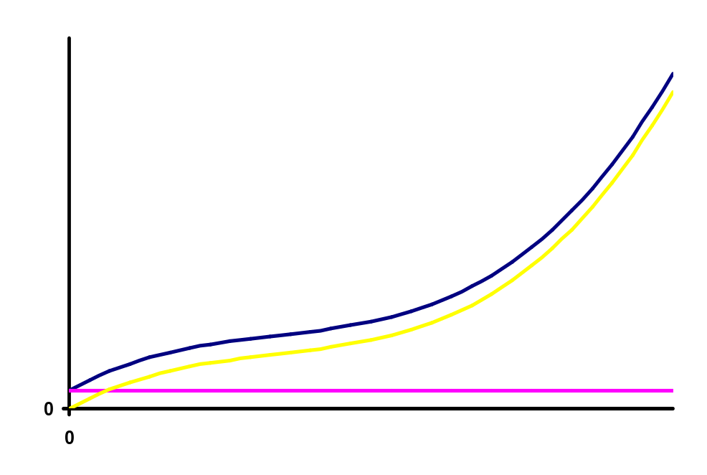
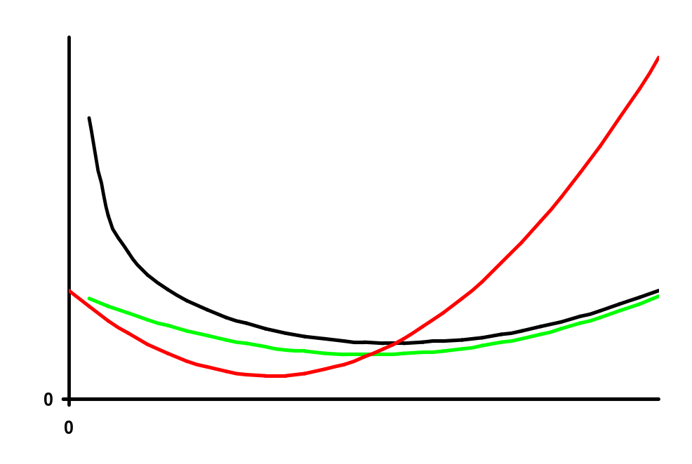
Cost Function Graphics
TC
VC
Cost
FC
MC
ATC
AVC
Output Q

Slide 25

Cost Function Graphics
MC
Cost
ATC
AVC
Output Q

Slide 26
Livestock Example
Suppose you have pasture and will stock steers over the summer to sell in the fall
As add more steers, eventually the rate of gain decreases as forage per animal falls (diminishing marginal product)
Fixed cost = $5,000 in land opportunity costs, depreciation on fences and watering facilities, insurance, property taxes, etc.
Variable cost = $495/steer: buying, transporting, vet costs, feed supplements, etc.

Slide 27
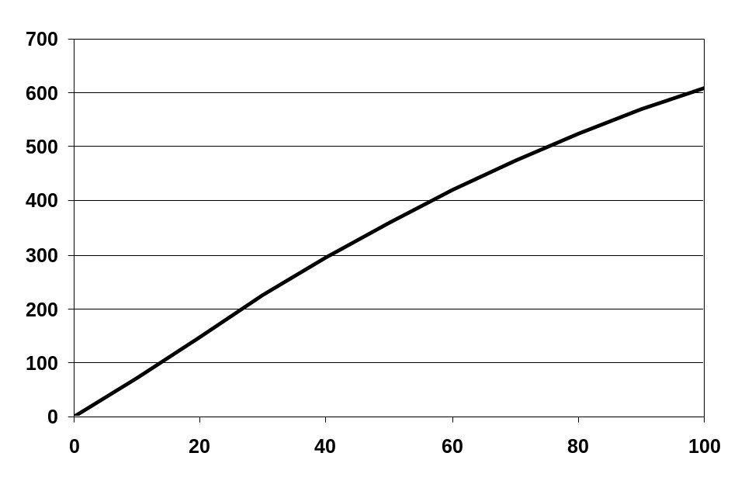
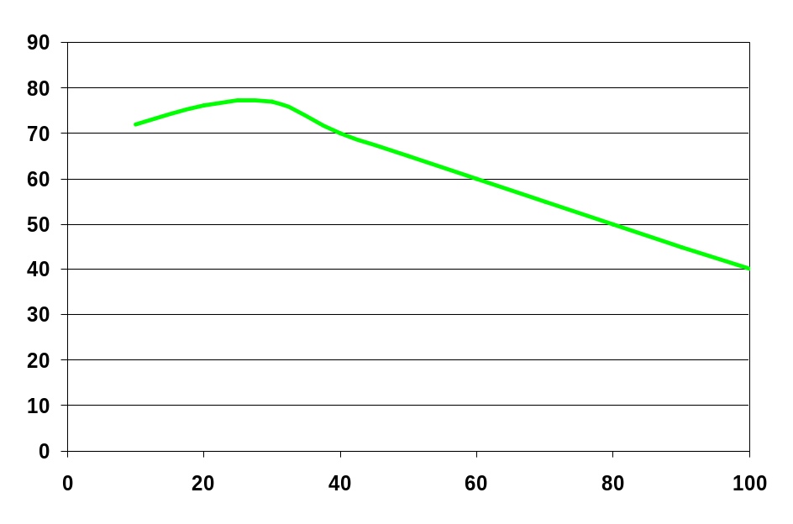
Steers X | Beef Q | MP
0 | 0
10 | 72 | 7.2
20 | 148 | 7.6
30 | 225 | 7.7
40 | 295 | 7.0
50 | 360 | 6.5
60 | 420 | 6.0
70 | 475 | 5.5
80 | 525 | 5.0
90 | 570 | 4.5
100 | 610 | 4.0
Production Function
Beef (cwt)
Marginal Product (cwt)
Steers

Slide 28
Think Break #9 (Review)
Steers X | Beef Q | MP | VMP
0 | 0
10 | 72 | 7.2 | 648
20 | 148 | 7.6 | 684
30 | 225 | 7.7 | 693
40 | 295 | 7.0 | 630
50 | 360 | 6.5
60 | 420 | 6.0
70 | 475 | 5.5
80 | 525 | 5.0 | 450
90 | 570 | 4.5 | 405
100 | 610 | 4.0 | 360
How many steers should you stock if the expected selling price is $90/cwt and steers cost $495 each?
Hint: What’s the single input optimality condition?

Slide 29
Steers X | Beef Q | F Cost | V Cost | Total C | AVC | ATC | MC
0 | 0 | 5,000 | 0 | 5,000
10 | 72 | 5,000 | 4,950 | 9,950 | 68.75 | 138.19 | 68.75
20 | 148 | 5,000 | 9,900 | 14,900 | 66.89 | 100.68 | 65.13
30 | 225 | 5,000 | 14,850 | 19,850 | 66.00 | 88.22 | 64.29
40 | 295 | 5,000 | 19,800 | 24,800 | 67.12 | 84.07 | 70.71
50 | 360 | 5,000 | 24,750 | 29,750 | 68.75 | 82.64 | 76.15
60 | 420 | 5,000 | 29,700 | 34,700 | 70.71 | 82.62 | 82.50
70 | 475 | 5,000 | 34,650 | 39,650 | 72.95 | 83.47 | 90.00
80 | 525 | 5,000 | 39,600 | 44,600 | 75.43 | 84.95 | 99.00
90 | 570 | 5,000 | 44,550 | 49,550 | 78.16 | 86.93 | 110.00
100 | 610 | 5,000 | 49,500 | 54,500 | 81.15 | 89.34 | 123.75

Slide 30
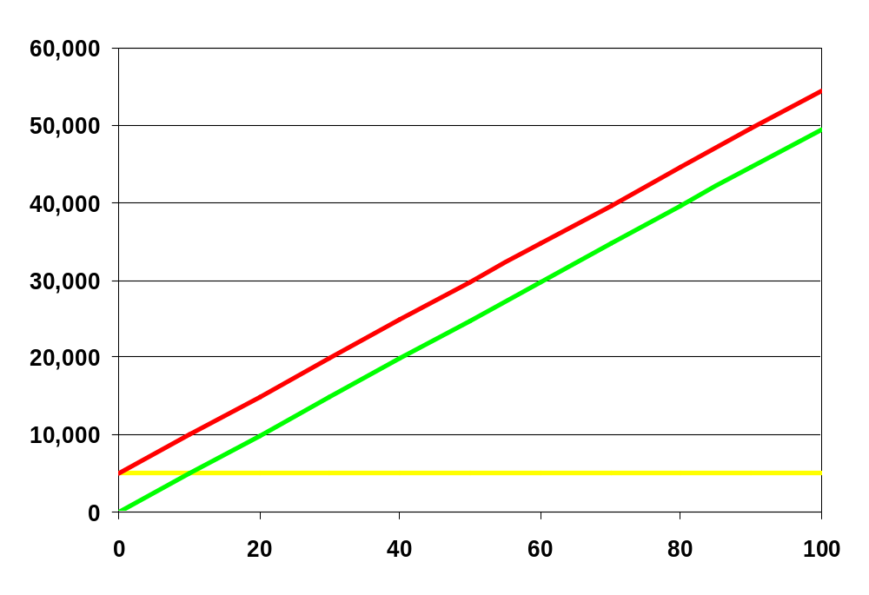
Why aren’t these FC, VC and TC curves?
Costs $
Steers X

Slide 31
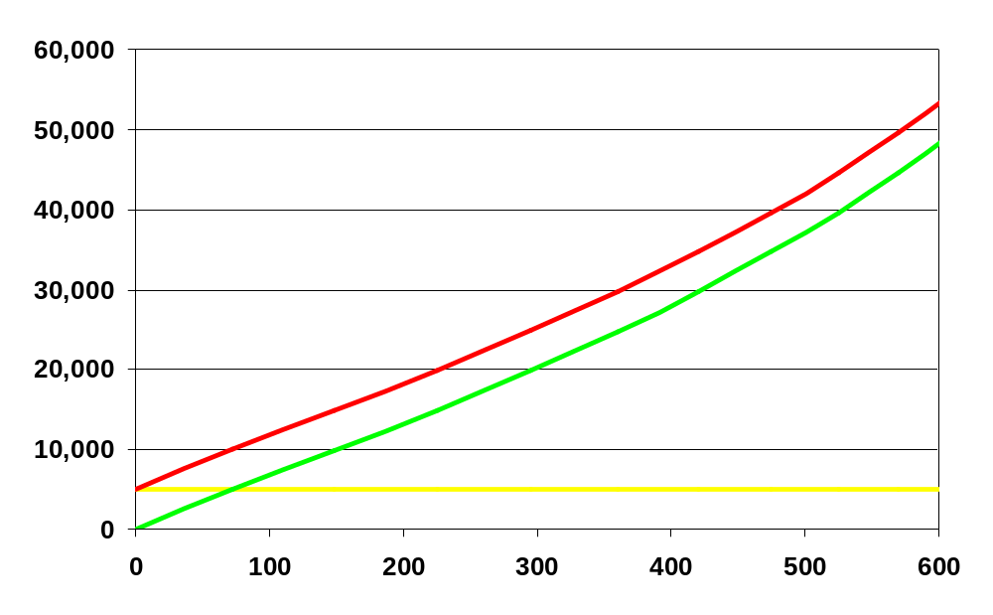
Because MP decreases, TC and VC increase more and more rapidly as output increases (that’s duality)
TC
VC
Costs $
FC
Beef Produced (cwt) Q

Slide 32
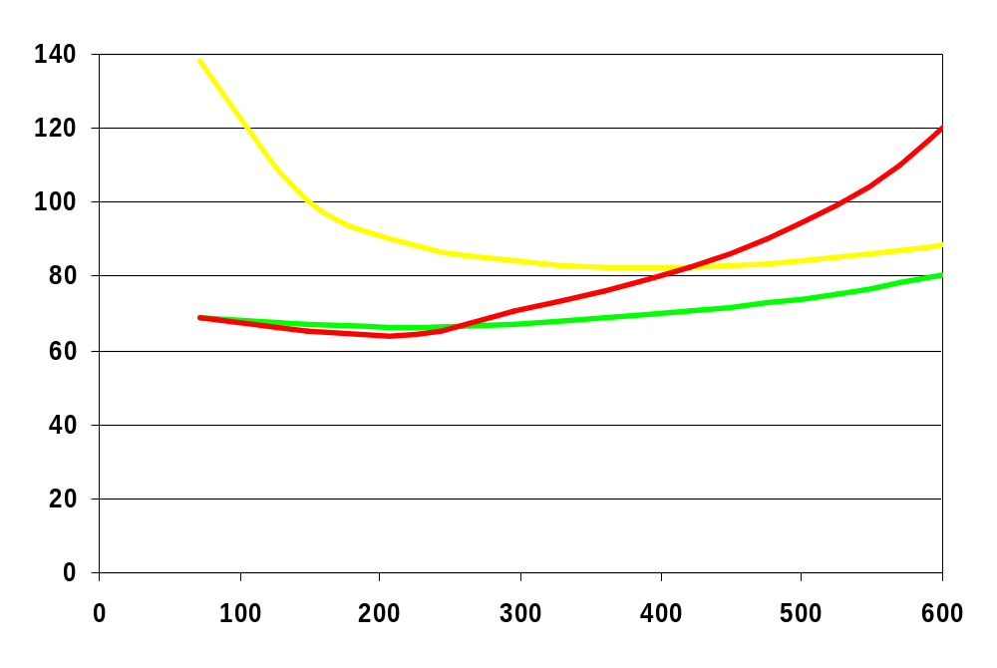
ATC
MC
Costs $
AVC
Beef Produced (cwt) Q

Slide 33
Profit Maximization and
Cost Functions
Choose output Q to maximize profit
Max π = pQ – C(Q)
FOC: dπ/dQ = p – MC(Q) = 0
  Choose output Q so that price equals marginal cost will maximize profit
SOC: d²π/dQ² = – MC’(Q) < 0, or C’’(Q) > 0
  Need a convex cost function (diminishing marginal product)

Slide 34
Steers X | Beef Q | MP | VMP | F Cost | V Cost | Total C | AVC | ATC | MC
0 | 0 |  |  | 5,000 | 0 | 5,000
10 | 72 | 7.2 | 648 | 5,000 | 4,950 | 9,950 | 68.75 | 138.19 | 68.75
20 | 148 | 7.6 | 684 | 5,000 | 9,900 | 14,900 | 66.89 | 100.68 | 65.13
30 | 225 | 7.7 | 693 | 5,000 | 14,850 | 19,850 | 66.00 | 88.22 | 64.29
40 | 295 | 7.0 | 630 | 5,000 | 19,800 | 24,800 | 67.12 | 84.07 | 70.71
50 | 360 | 6.5 | 585 | 5,000 | 24,750 | 29,750 | 68.75 | 82.64 | 76.15
60 | 420 | 6.0 | 540 | 5,000 | 29,700 | 34,700 | 70.71 | 82.62 | 82.50
70 | 475 | 5.5 | 495 | 5,000 | 34,650 | 39,650 | 72.95 | 83.47 | 90.00
80 | 525 | 5.0 | 450 | 5,000 | 39,600 | 44,600 | 75.43 | 84.95 | 99.00
90 | 570 | 4.5 | 405 | 5,000 | 44,550 | 49,550 | 78.16 | 86.93 | 110.00
100 | 610 | 4.0 | 360 | 5,000 | 49,500 | 54,500 | 81.15 | 89.34 | 123.75

Slide 35
P = MC and VMP = r
Cost Function based optimality condition
P = MC identifies Q = 475 cwt as the profit maximizing output
  To produce Q = 475 cwt requires 70 steers
Production Function based optimality condition VMP = r identifies Steers = 70 as the profit maximizing input use
  Buying 70 steers produces Q = 475 cwt
Optimality conditions are consistent with each other because of duality

Slide 36
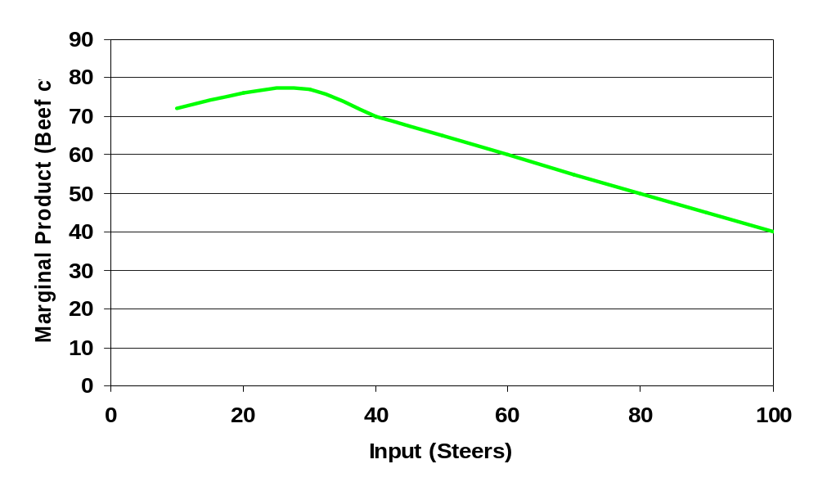
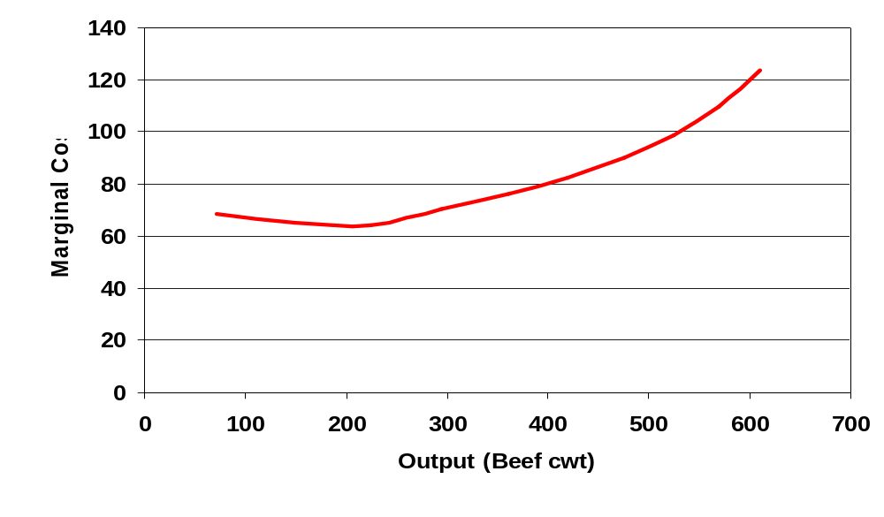
marginal cost increases because marginal product decreases

Slide 37
Think Break #10
You work for UWEX and have data on several farms in your seven county district
You look at all farms with similar sized milking parlors and a similar number of workers
You calculate the average production per cow as the number of cows varies among the farms
Use these data in the table to recommend the optimal milk output and herd size

Slide 38
Think Break #10
Cows X | Milk Q cwt | FC | VC | TC | MC
0 | 0 | 10000 | 0 | 10000 | 0
20 | 4800 | 10000 | 67000 | 77000 | 13.96
40 | 9640 | 10000 | 134000 | 144000 | 13.84
60 | 14490 | 10000 | 201000 | 211000
80 | 19320 | 10000 | 268000 | 278000
100 | 24100 | 10000 | 335000 | 345000
120 | 28824 | 10000 | 402000 | 412000 | 14.18
140 | 33488 | 10000 | 469000 | 479000 | 14.37
160 | 38096 | 10000 | 536000 | 546000 | 14.54
180 | 42624 | 10000 | 603000 | 613000 | 14.80
200 | 47060 | 10000 | 670000 | 680000 | 15.10
(VC = $3350/cow)
Fill in the missing MC’s
If the milk price is $14/cwt, what is the optimal milk output and farm size?

Slide 39
MC = Output Supply Curve
Maximize π = PQ – TC(Q) gives P = MC(Q)
P = MC(Q) defines the supply curve — for any price P, how much output Q to supply
Profit changes along the MC curve, but for the given price, the maximum is on the MC curve
Think of MC curve as a line defining the peak of a long ridge, with the elevation of the peak (profit) changing along the line

Slide 40
ATC defines Zero Profit
With free entry and exit and competition, long run economic profit is zero—everyone earns a fair return for their time & assets
Set profit to zero and rearrange
PQ – TC(Q) = 0 becomes PQ = TC(Q), then P = TC(Q)/Q = ATC
P = ATC defines zero profit
Think of ATC curve as line defining sea level, below ATC means π < 0

Slide 41
MC = ATC at min ATC
ATC = TC(Q)/Q, use quotient rule to get first derivative, then set = 0 and solve
d(TC(Q)/Q)/dQ = (MC x Q – TC(Q))/Q² = 0
Rearrange to get MC x Q = TC(Q), and then MC = TC(Q)/Q = ATC
FOC implies MC = ATC at min ATC
Intersection between MC and ATC occurs when ATC is at a minimum
Min ATC: where profit max ridge hits the sea

Slide 42
MC = AVC at min AVC
Repeat process with AVC
d(VC(Q)/Q)/dQ = (MC x Q – VC(Q))/Q² = 0
Rearrange to get MC x Q = VC(Q), and then MC = VC(Q)/Q = AVC
FOC implies MC = AVC at min AVC
Intersection between MC and AVC occurs when AVC is at a minimum

Slide 43
Profit and min AVC
Profit at min AVC: π = PQ – VC(Q) – FC
P = MC = AVC at min AVC, so rewrite as
π = MC x Q – VC(Q) – FC
VC(Q) = (VC(Q)/Q) x Q = AVC(Q) x Q, so rewrite as π = MC x Q – AVC(Q) x Q – FC, or π = Q(MC – AVC(Q)) – FC
MC = AVC at min AVC, so MC – AVC = 0, so that π = – FC
Produce at P ≥ min AVC because, though lose money, still pay part of FC

Slide 44
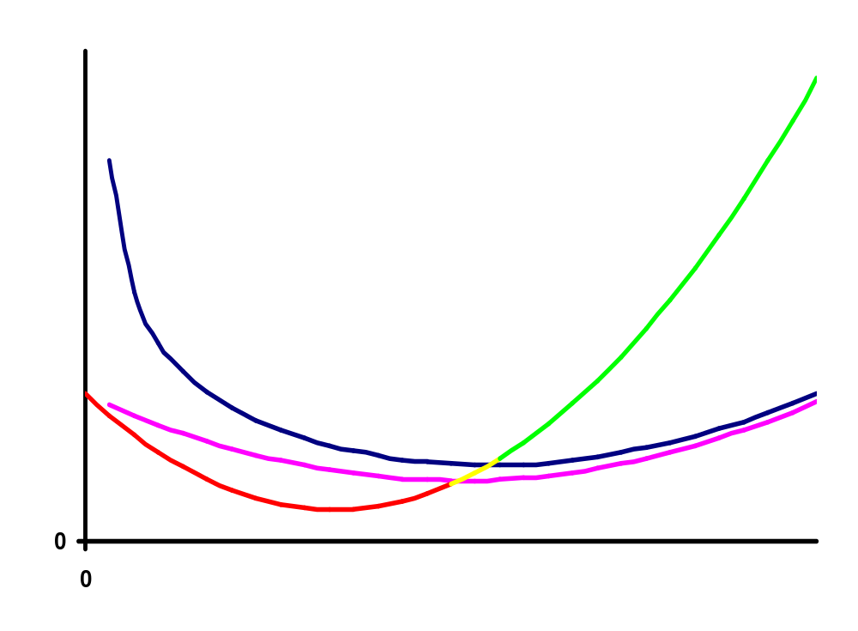
Cost Functions and Supply
Green: P ≥ min ATC and π ≥ 0
Yellow: min AVC ≤ P ≤ min ATC and – FC ≤ π ≤ 0
MC
Cost or Price
ATC
AVC
Output Q

Slide 45
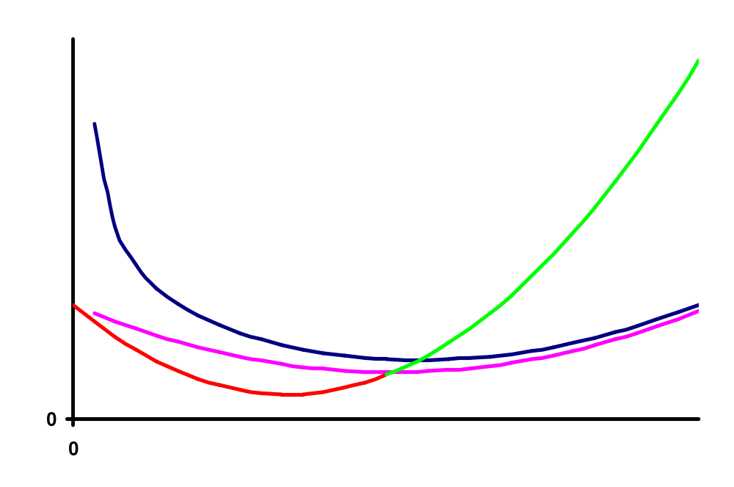
Cost Function and Supply
Green is complete supply schedule
MC
Cost or Price
ATC
AVC
Output Q

Slide 46
Think Break #11
Cows | Milk | VC | TC | MC | ATC | AVC
0 | 0 | 0 | 10000
20 | 4800 | 67000 | 77000 | 13.96 | 16.04 | 13.96
40 | 9640 | 134000 | 144000 | 13.84 | 14.94 | 13.90
60 | 14490 | 201000 | 211000 | 13.81 | 14.56
80 | 19320 | 268000 | 278000 | 13.87
100 | 24100 | 335000 | 345000 | 14.02
120 | 28824 | 402000 | 412000 | 14.18 |  | 13.95
140 | 33488 | 469000 | 479000 | 14.37 | 14.30 | 14.01
160 | 38096 | 536000 | 546000 | 14.54 | 14.33 | 14.07
180 | 42624 | 603000 | 613000 | 14.80 | 14.38 | 14.15
200 | 47060 | 670000 | 680000 | 15.10 | 14.45 | 14.24
These are the Think Break #10 data (FC = $10,000)
Fill in the missing costs
What do you recommend for farms this size if the milk price is $13/cwt?

Slide 47
What if P < min AVC?
Remember economic profit includes opportunity costs, so negative economic profit means better opportunities elsewhere
Your money/assets and time would get better returns in other activities
Choices when p < min AVC for long term
1) Quit and convert resources
2) Find new way to produce with lower average production costs (new technology)

Slide 48
Other Cost Terms Used
Fixed Cost synonyms: Overhead, Ownership Costs
Variable Costs synonyms : Operating Costs, Out-of-Pocket Costs
Direct vs Indirect: direct costs are linked to a specific enterprise (dairy), indirect are not (pickup truck, tractors). Both can be fixed and variable
Cash vs Non-Cash: Cash costs paid from farm income, while non-cash costs include depreciation, returns to equity, labor, management (opportunity costs). Both can be fixed and variable

Slide 49
Summary
Opportunity Cost
Cost Functions
  Definitions
  Graphics
Profit Maximization and Cost Functions
  Optimality conditions
  Graphics
  Output supply

